Slide 1
More Tools for your Superhero Utility Belt
December 8, 2020

Slide 2
Presenters
Joe Dawson, Digital Communications Specialist, NCIPH, UNC Chapel Hill
Margaret Benson Nemitz, MPH, Community Assessment Coordinator, NCIPH, UNC Chapel Hill

Slide 3
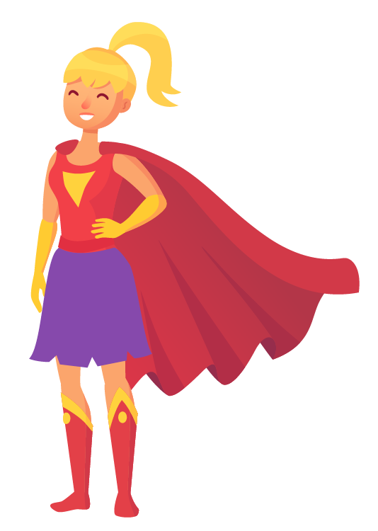
Winter Series
Annual Update Webinar
January 21, 2021
9—11 a.m.
Registration is open.
Every January an update webinar is held to share NCLHDA Program updates for the coming year. All local health departments are encouraged to have at least one accreditation team member join the webinar. This year will provide an overview of the rollout of revision to the HDSAI Interpretation Document.

Slide 4
Canva
Jamboard
Tableau Public

Slide 5
Canva Webinar
December 2020

Slide 6
Why do graphic design?

Slide 7
Why do graphic design?

Slide 8
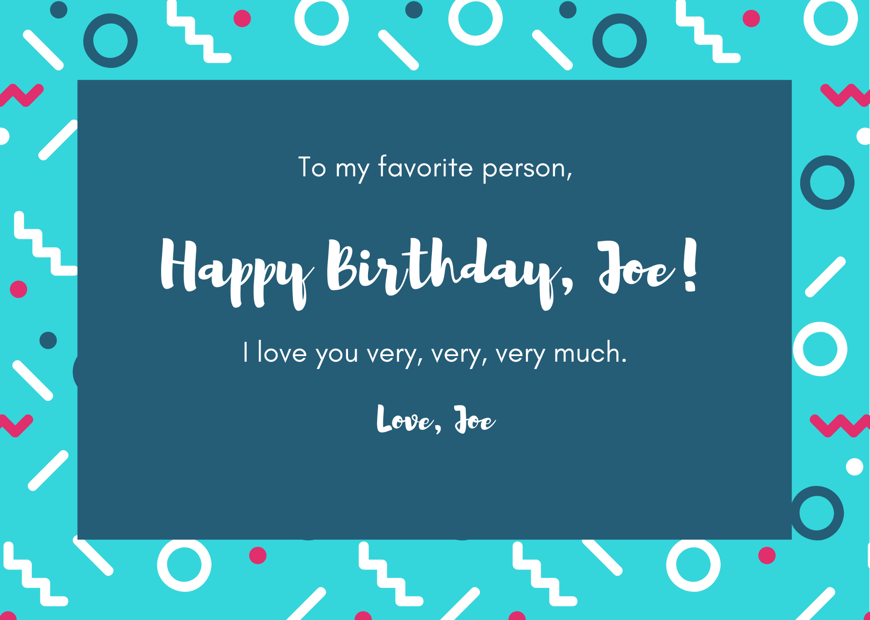
Why do graphic design?

Slide 9
Why do graphic design?
Like it or not, appearance matters. Attractive designs grab attention better and actually help people digest info better.
With a few resources, it doesn’t take much time or serious graphic design skills.

Slide 10
What is Canva?
A free, online graphic design program.
Access it at Canva.com

Slide 11
Basic Functions: Shapes

Slide 12
Basic Functions: Colors

Slide 13
Basic Functions: Text

Slide 14
Text
Created in boxes
Can edit what’s on the layout already
Can create new text
Tips for font selection
be appropriate (tone and readability)—no goofy fonts on serious documents.
Use 2 fonts maximum. Including more than three fonts tends to make things harder to read.

Slide 15
Basic Functions: Photos

Slide 16
Basic Functions: Positions

Slide 17
Basic Functions: Pages

Slide 18
Templates

Slide 19
Templates
Filtered by design type
Named
Can search, scroll through
Customizable

Slide 20
Downloading Your Designs

Slide 21
First Steps: As soon as we’re done:
Canva.com→ Create your account
Play around: https://designschool.canva.com/tutorials/getting-started/canva-starter-challenge/
https://designschool.canva.com/tutorials/getting-started/

Slide 22
Canva Questions

Slide 23
Canva
Jamboard
Tableau Public

Slide 24
Jamboard Questions

Slide 25
Canva
Jamboard
Tableau Public

Slide 26
Tableau Public Basics
Free platform
Lots of support
Easy to share
Data saved on Tableau Public’s server
Need to reformat data

Slide 27
Chatham County Community Assessment
NCLHDA Annual Survey Results
Durham City and County Resident Survey
Today’s Training Dashboard
Examples

Slide 28
Getting Started
1
Create an account at public.tableau.com
2
Download Tableau Public on your computer

Slide 29
Tableau Public How-to Videos
Tableau Community Forums
… & the world wide web!
Resources

Slide 30
Tableau Public Questions

Slide 31
Reminder: Public Comment Period
Who: | Open to anyone!
What: | A chance to review draft revisions to the HDSAI Interpretation Document, by activity
When: | November 5 – December 12, 2020
Where: | nclhdaccreditation.unc.edu\updates\calling-all-accreditation-stakeholders\

Slide 32
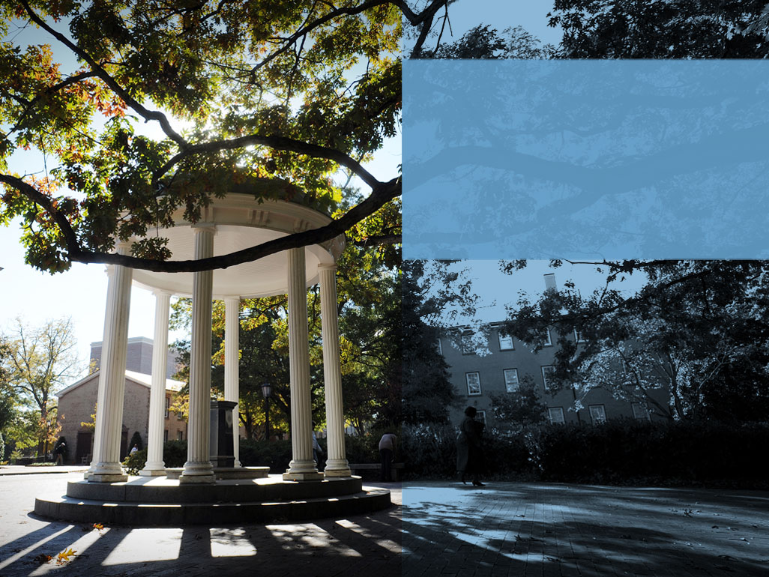
Thank you
Margaret Benson Nemitz Community Assessment Coordinator margaret.nemitz@unc.edu
Joe Dawson
Digital Communications Specialist
joedawson@unc.edu
The North Carolina Local Health Department Accreditation Program is part of the North Carolina Institute for Public Health at the Gillings School of Global Public Health at the University of North Carolina at Chapel Hill.

