Slide 1
Roles and Responsibilities of Boards of Health
Related to North Carolina Local Health Department Accreditation (NCLHDA)
Updated December 8, 2023

Slide 2
Presentation Overview
Review of purpose of accreditation
Identification of activities related to Board of Health involvement
Finance
Community Health
Health Director/Staff
Rules and Ordinances
Board Function
Questions and Comments
Notes:
This presentation aims to provide a basic review of how the N.C. Local Health Department Accreditation program specifically addresses Board of Health roles and responsibilities. We will start by reviewing the purpose of accreditation and then discuss specific Board of Health-related activities around five domains — Finance, Community Health, Health Director/Staff, Board Training and Materials, and Rules and Ordinances. We will then clarify how the Board is involved in these activities, from simply having a policy or reviewing a report, to discussing or approving items and taking other actions.

Slide 3
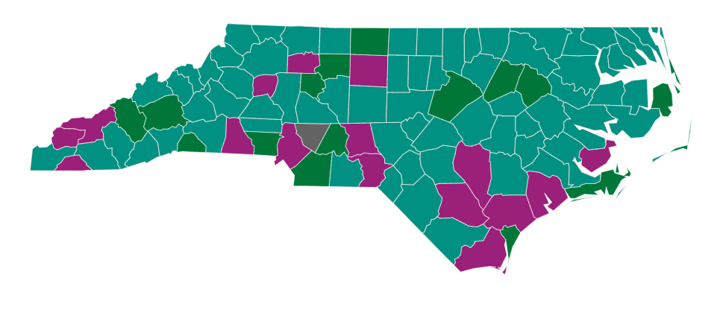
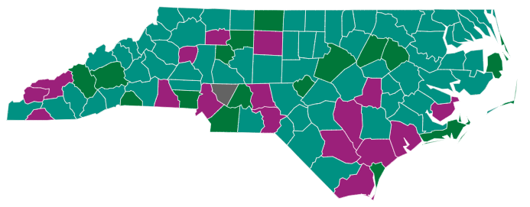
Public Health Governance Structures
 | Appointed CHS Board |  | Appointed PH Board |  | BOCC as Governing Body |  | Public Hospital Authority – Appointed Board of Commissioners
Map updated 12/7/2023. Current map available at https://humanservices.sog.unc.edu/visualization-all/
Notes:
Note that this presentation is applicable to all Board of Health governance structures. Unless otherwise stated (such as specific mention/inclusion of the Advisory Committee of Health being able to meet that activity), the activity is required of whatever Board (traditional Board of Health, Consolidated Human Services Board, or Board of County Commissioners) assumes the powers/duties of the traditional Board of Health. The general term “Board” is used throughout this presentation in reference to the governing board with oversight to public health activities. Accreditation activity language was changed in June 2015 to better clarify the changing governance structures many local county governments have implemented. In general, if the Board of County Commissioners (BOCC) or a Consolidated Human Services (CHS) Board has assumed the powers and duties of the Board of Health, then it shall be responsible for all duties assigned to the Board of Health by any law or rule. Therefore, for any standard/benchmark/activity within the accreditation standards that states “the Board of Health shall,” the BOCC or CHS Board that has assumed the duties of the Board of Health must comply with that requirement. The only exception is if activity language specifically allows a Health Advisory Committee (when Board of County Commissioners has assumed duties/responsibilities of Board of Health) to address specific activities. In general, however, Health Advisory Committees do not have rule-making authority and therefore cannot carry out the responsibilities set forth in many of the Board of Health-related activities.

Slide 4
Basic Components of the Process
Self-Assessment by the Agency
147 Activities & 41 Benchmarks
Site Visit
Peer volunteers
Administration, Environmental Health, Nursing, Board of Health (BOH)
Review documentation, tour facilities and conduct interviews
Site Visit Report — recommendation
Board Adjudication
Notes:
Very briefly, the three components of the process are:
- A Health Department Self-Assessment Instrument (HDSAI) is completed by the health department,
- A site visit is conducted by a multidisciplinary team of peer volunteers, and
- Accreditation status is determined by an independent Accreditation Board.

Slide 5
Activities and Scoring Requirements
Agency Core Functions and Essential Services
Assessment: Department must meet 26 of 29 activities
Policy Development: Department must meet 23 of 26 activities
Assurance: Department must meet 34 of 38 activities
Facilities and Administrative Services
Department must meet 24 of 27 activities
Governance
Department must meet 24 of 27 activities
Notes:
The 147 activities and 41 benchmarks are broken down into three main standards. Each standard (or substandard) has a minimum number of activities that must be met to be accredited. Note that, not surprisingly, most of the activities that affect the Board are in the Governance standard. If an agency is assessed four or more “Not Mets” under Governance, they will not be recommended for reaccreditation — what the Board of Health does for local public health is very important, and the accreditation standards reflect this importance.

Slide 6
The Life Cycle of Accreditation
LHD uploads evidence into dashboard
Review of evidence by Site Visitors
Reports finalized and sent to LHD with accreditation recommendation
LHD has 10 days to provide written response to findings
NCLHDA Board votes on accreditation recommendation and awards status
LHD is between cycles
NCIPH notifies LHD that HDSAI is due within 90 days
Notification to official award takes ~ 9.5 months
Preparation for next accreditation cycle begins
6
Notes:
This is the overall accreditation cycle. While many people think of accreditation as the crunch time of the nine and a half months from 90-day notification to the award of status at the Board meeting, it is very much a continuous process. As local Agency Accreditation Coordinators should know well, preparation for the next accreditation cycle begins the day after the conclusion of the site visit. As the evidence requirements stand now, there are a number of activities that require annual effort — these things take concerted planning and continuous attention throughout the four year cycle.

Slide 7
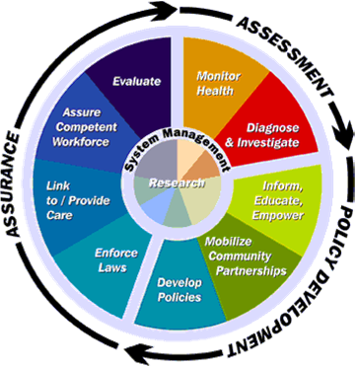
Purpose of NCLHDA Program
The focus of NCLHDA is on the capacity of the local health department (LHD) to perform at a prescribed, basic level of quality
Notes:
We forget about this sometimes, but remember that the whole reason we do this is to verify the ability of local health departments to fulfill the 10 essential services of public health.
Focus of North Carolina Local Health Department Accreditation
The focus of North Carolina’s Local Health Department Accreditation (NCLHDA) is on the capacity of the local health department to perform at a prescribed, basic level of quality the three core functions of assessment, assurance and policy development and the ten essential services.
Accreditation strives to guarantee that anyone in N.C. can walk into any local health department in the state and be assured that the services received will be competently delivered at a basic level of quality.
Accreditation of a local health department certifies to the general public that the agency:
Has an appropriate community mission and purpose.
Has the resources needed to accomplish its mission and purpose.
Can demonstrate that it is accomplishing its mission and purpose.
Gives reason to believe that it will continue to accomplish its mission and purpose.

Slide 8
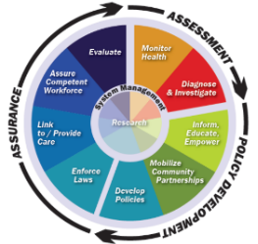
Connecting the Dots
Current public health practice
Existing contractual and program monitoring requirements for the Division of Public Health
NOT a wholly new
accountability system
Essential Services & Core Functions
State statutes and administrative code
Notes:
The NCLHD Accreditation is not a wholly new accountability system. It is linked and guided by state statute and administrative code as well as existing contractual and program monitoring requirements from DPH. At its core, it is informed and tied to the essential services of public health and current public health practice.

Slide 9
Accreditation provides a framework for a health department to:
Identify performance improvement opportunities
Improve management
Develop leadership
Improve relationships with the community
“The process is one that will challenge the health department to think about what business it does and how it does that business.”
Public Health Accreditation Board, 2013
Notes:
Addressing accreditation requirements can help you assess what business you do and how you deliver services to your community. Accreditation should assist a health department in identifying areas for improvement, improving management, developing leadership and improving relationships with the community.

Slide 10
Results of 2023 Survey: Quality Improvement
The percentage of respondents (n=140) who strongly agreed or agreed that participating in the NCLHDA Program:
Improves Specific Processes and Policies within Agencies
Stimulates QI and Performance Improvement Opportunities within Our Agency
76%
73%
cv
71%
Helps Our Agency Become More Effective
61%
Helps Our Agency Become More Efficient
Notes:
LHDs in North Carolina reported in the 2023 NCLHDA Annual Survey (capturing the 2022-2023 fiscal year, conducted in May 2023) that accreditation helped them in many areas of quality improvement.

Slide 11
Results of 2023 Survey: Strategy Development
The percentage of respondents (n=140) who strongly agreed or agreed that participating in the NCLHDA Program:
Helps our agency focus on key priorities
Gives our agency objective information to request funding and/or other resources
65%
64%
cv
Encourages our agency to think about what business our agency does
66%
52%
Helps our agency address health equity
Notes:
Accreditation also assisted agencies with utilizing strategy to guide their mission and work.

Slide 12
Results of 2023 Survey: Relationship Building
The percentage of respondents (n-140) who strongly agreed or agreed that participating in the NCLHDA Program:
Gives Our Agency Credibility with Our Partners
Improves cross division/unit/ department work
67%
64%
cv
Gives Our Agency Credibility with Our Community
65%
56%
Improves relationships with our community
Notes:
Likewise, the 2023 survey also demonstrated how accreditation helped with agency relationships.

Slide 13
Results of 2023 Survey: Other Identified Sources of Value
Builds collaboration between colleagues, county partners, and other agencies
Provides impetus on strategic work, policy, and training elements that can otherwise get put off
Builds confidence in agency – both internally and amongst partner organizations
Notes:
The 2023 survey also identified a number of other internal and external sources of value and benefit.

Slide 14
Being accredited helps position health departments and give them credibility as a respected player in the future of integrated healthcare and population health initiatives.
Notes:
Additionally, in the changing health care and population health realm since passage of the Affordable Care Act, being accredited helps position health departments and give them further credibility as respected players in the future of integrated health care and population health initiatives.

Slide 15
The Law
Senate Bill 804
Established NCLHDA Board within N.C. Institute for Public Health (17 members appointed by N.C. Department of Health and Human Services Secretary)
Directs Commission to adopt rules establishing standards for LHDs
Mandates all LHDs to obtain (by December 1, 2014) and maintain accreditation
10A NCAC 48B
Defines scoring requirements by
core function
Describes Benchmarks and Activities
Notes:
Lastly, health departments in N.C. are required by General Statute to be accredited and maintain accreditation status. Additionally, G.S. 130A-34.4 states that by July 1, 2014, in order for a local health department to be eligible to receive state and federal public health funding from the Division of Public Health, they must obtain and maintain accreditation pursuant to G.S. 130A-34.1.

Slide 16
Board Role
Ensure you have required policies, procedures or materials.
Hear or review LHD reports.
Discuss service costs, need for new/amended rules or ordinances.
Approve fees and budgets.
Take other actions or be involved with efforts to assure the health department has what it needs to do its job.
Notes:
Though the LHD may do the majority of the “work” for accreditation, the Board must ensure that they have required policies, procedures and materials. The Board must hear and review certain LHD reports that the Board should be aware of and knowledgeable of. Third, the Board must DISCUSS certain things such as service costs and the ongoing need for new or amended rules and ordinances. The accreditation language is very clear in these specific requirements that the Board must take an active stance and not only review and hear certain things from the LHD, but that they must discuss as a group and that discussion must be recorded in Board meeting minutes. Fourth, the Board must approve things like fees, budgets and Health Director personnel components. Lastly, the Board must take other action or be involved in advocacy or communication efforts to ensure the health department has what it needs to ensure the ten essential services of public health.

Slide 17
Finance
The Board must:
Review financial reports.
Discuss service costs as well as approve fees and final budget.
Advocate with a wide array of funders in support of LHD efforts to secure financial resources to provide essential services.
Notes:
As stated before, there are a number of specific activities related to finance that are assigned to the Board. In general, however, the Board must review financial reports, discuss service costs and approve agency fees and final annual budget. The Board must also advocate with a number of different funders to secure financial resources so that the health department can do its job.

Slide 18
Community Health
The Board must:
Ensure input on community health improvement efforts.
Hear reports on community health.
Support partnership and coordination of resources.
Educate and advocate with community leaders about community health issues and support for these issues.
Notes:
There are a number of important accreditation requirements that demonstrate how important it is for the Board to be involved with and leading the charge for community health improvement. In general, the Board must ensure that both the LHD and community have a voice on community health improvement identification and planning efforts. They must also hear reports from the LHD on annual epidemiology trends, community health statistics and annual State of the County Health reports. The Board must hear reports on Community Health Assessments, specifically the data involved. Also, the Board must discuss and support partnership efforts and the effective coordination of resources throughout the community in addressing community health improvement efforts. Lastly, the Board must educate and advocate with community leaders about community health issues and their support for them.

Slide 19
Health Director/Staff
The Board must:
If the Health Director position becomes vacant, make and implement plans to recruit and secure a credentialed and qualified new Health Director.
Review and approve the Health Director’s job description and performance evaluation.
Notes:
The Board has a number of responsibilities related to the Health Director and staffing. The Board must assess the Health Director position by reviewing the Health Director job description and performance evaluation, with sign-off on both. If the LHD has a current Health Director vacancy or has had a vacancy since the last site visit, the Board must demonstrate that they made plans and took effort to determine what the LHD needed as a leader as well as what credentials/qualifications the new Health Director had to have and that they recruited and hired accordingly.

Slide 20
Board Function
Board members must receive initial (within the first year of appointment) and ongoing training on BOH roles and responsibilities.
Board must have Operating Procedures, an annually updated handbook and a training policy/procedure.
Notes:
To ensure a competent and effective Board, there are a number of accreditation requirements regarding basic Board functions. First, new BOH members must undergo initial training within their first year of appointment, and all Board members must undergo continuing education training according to the agency schedule (at least once since last site visit). Both of these trainings must be related to the roles and responsibilities of Boards of Health. Additionally, the Board must have Operating Procedures (not By-laws), an annually updated handbook and a policy/procedure for Board training.

Slide 21
Rules & Ordinances
The Board must:
Have access to legal counsel and statutes.
Have policies for rulemaking and appeals and demonstrate it is following said policies.
Along with the LHD, evaluate the need for additional or amended rules/ordinances.
Support prohibition of tobacco within 50 feet of all LHD facilities.
Notes:
Lastly, the Board is assigned a number of activities regarding its role in developing and enforcing rules and ordinances. The Board must demonstrate that it has access to legal counsel when it needs rule-related consultation and has access to public health statutes regarding rule-making. Additionally, the Board must have adopted policies for rulemaking and appeals/adjudications and if a rule or ordinance has been adopted or amended since the last site visit (or if there has been an appeal), must demonstrate that it followed those policies (if a rule/ordinance has not been adopted or amended and/or an appeal has not been submitted, the Board Chair may submit a statement stating such). The Board must also undertake a regular process to evaluate, with LHD staff and expertise, the need for additional or amended rules or ordinances — again, not that a rule/ordinance must be created, but that the need for such was analyzed and assessed. Lastly, the Board must support the prohibition of tobacco products (not just no-smoking) within 50 feet of all LHD facilities.

Slide 22
What can you do to be a “good” BOH member?
Attend meetings regularly so quorums are reached and, thus, required items can be approved on schedule.
Document your activities regarding community health and
contribute to discussion during Board meetings.
Carefully review meeting minutes to make sure your comments were captured.
3. Complete required trainings promptly.
Notes:
I am sure your health department and community greatly appreciate your willingness to serve on the Board of Health, and appreciate you being here today for this training. This has certainly been a lot of information, but remember that documenting items for accreditation activities is the responsibility of health department staff — your Agency Accreditation Coordinator (AAC) can give you much more detail about all of the requirements related to the Board of Health, and staff will guide you through addressing the necessary activities. However, there are a couple of things you can do to assist in ensuring the success of your local health department’s accreditation program. One is to regularly attend meetings as, as you have seen, there are a number of activities which require action by approval and that can only be done through establishment of a quorum. Secondly, make sure you share any activities you may do regarding community health with your Health Director or AAC — they may contribute to meeting a requirement. In the same vein, contribute and encourage discussion during Board meetings and carefully review meeting minutes to make sure comments were captured (if you don’t document it, it didn’t happen!). Lastly, complete required training promptly as it is often time-sensitive.

Slide 23
Questions & Comments
Notes:
Thank you very much for your time and attention today. Are there any further questions or comments?

Slide 24
Thank you.
For additional information about the NCLHDA Program visit: https://NCLHDaccreditation.unc.edu For questions please email: NCLHDaccreditation@unc.edu
The North Carolina Local Health Department Accreditation Program is part of the North Carolina Institute for Public Health at the Gillings School of Global Public Health at the University of North Carolina at Chapel Hill.
24

Slide 25
Important Notes
Italics: requirement may apply depending on governance structure, whether other documentation options are chosen/not chosen and whether there is a Health Director vacancy.
*Health Director may serve, or be directed by the Board to serve, as the designee for the BOH for correspondence. However, it is expected that there be some type of link to and from the BOH showing their involvement and engagement.
Notes:
As we go through the following, please reference the “Roles and Responsibilities of Boards of Health Related to N.C. Local Health Department Accreditation (NCLHDA)” guide that was displayed on the last slide. As that guide states, this is a general overview and tool that can be used by any Board of Health governance structure. Activity requirements that may be different based on governance structure, if other documentation options are chosen or not chosen or if there is a Health Director vacancy (or one since last site visit) are noted in italics. There are also a number of activities (identified with an asterisk) for which the Health Director may serve as the designee for the BOH. Note that for these activities, there MUST be some sort of link between the Board and Health Director demonstrating that the Board was updated and thus involved and engaged in the activity. Again, for more details, please reference the HDSAI and HDSAI Interpretation document.

